Slide 1
Demo 1 Presentation
Group 13 - FarmFriend

Slide 2
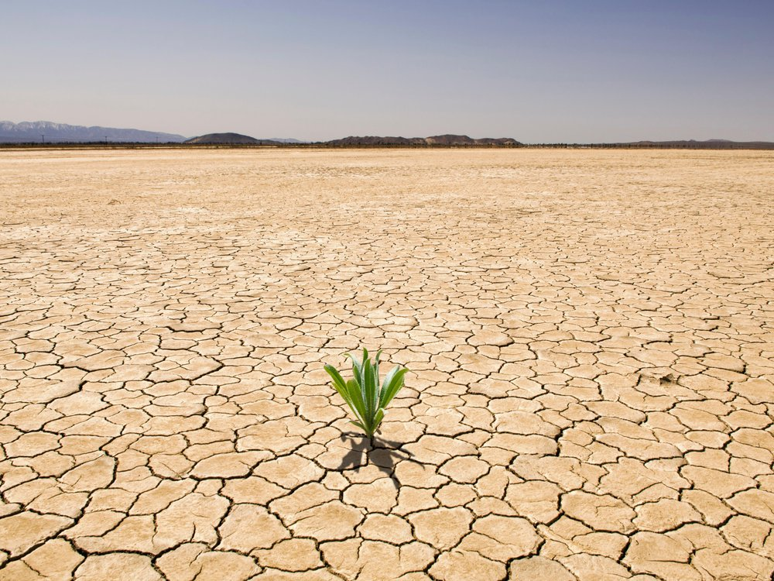
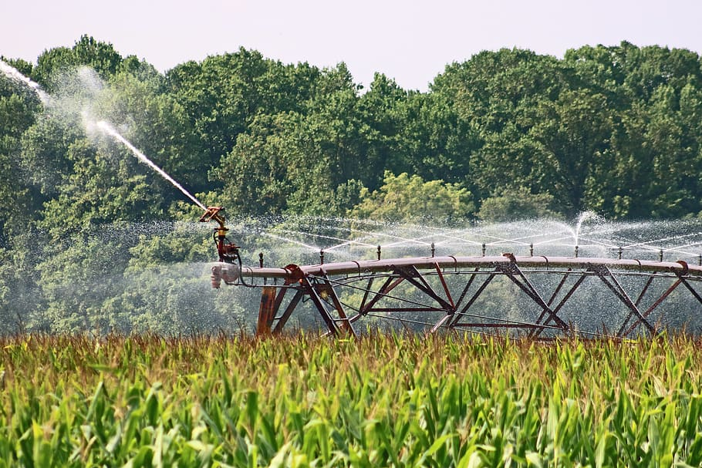
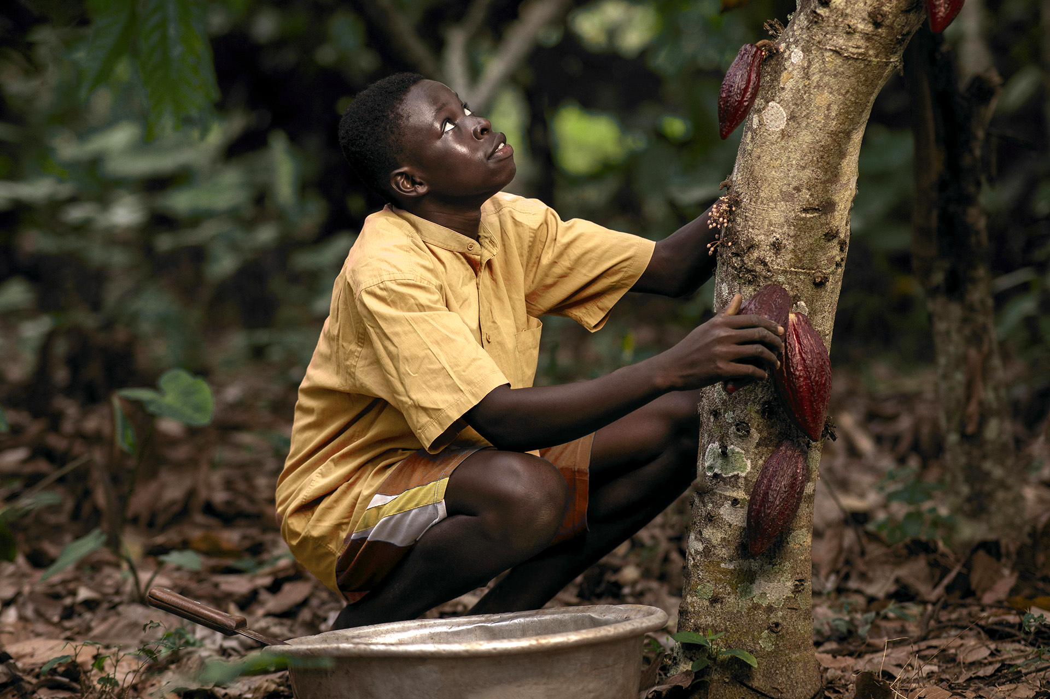
12,000,000
Hectares of land are lost annually due to drought and desertification
Notes:
https://www.syngenta.com/en/innovation-agriculture/challenges-modern-agriculture

Slide 3
Table of contents
Value Proposition
Overview
01
02
Progress
Demonstration
03
04
Summary and motivation behind the project
How the system is envisioned to be used
Technical progress made thus far
Physical functional demonstration of the robot

Slide 4

Introduction
The FarmFriend robotic system monitors soil health, and can act to varying levels of pH by stabilising soil to a pH that is most optimal for the crop being grown.

Slide 5
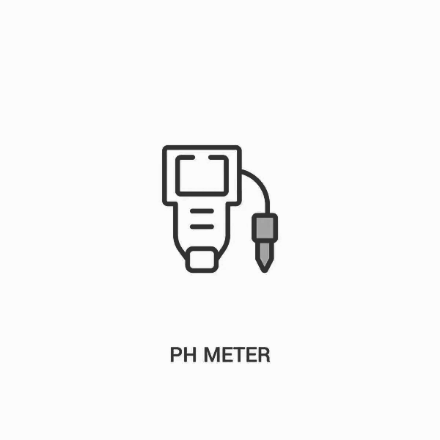
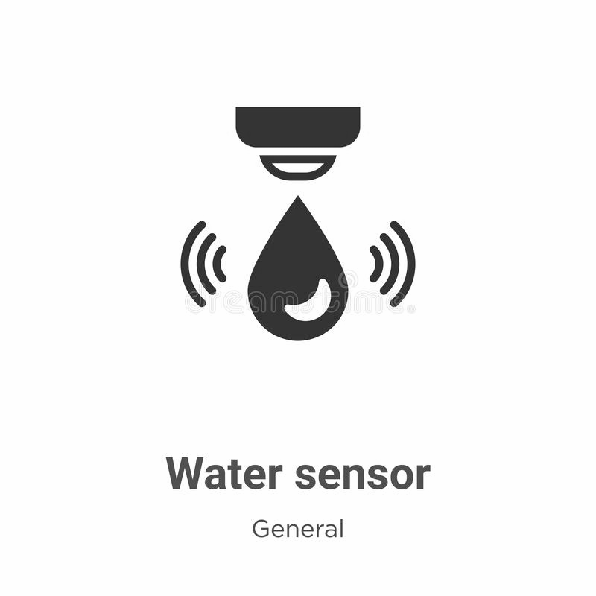
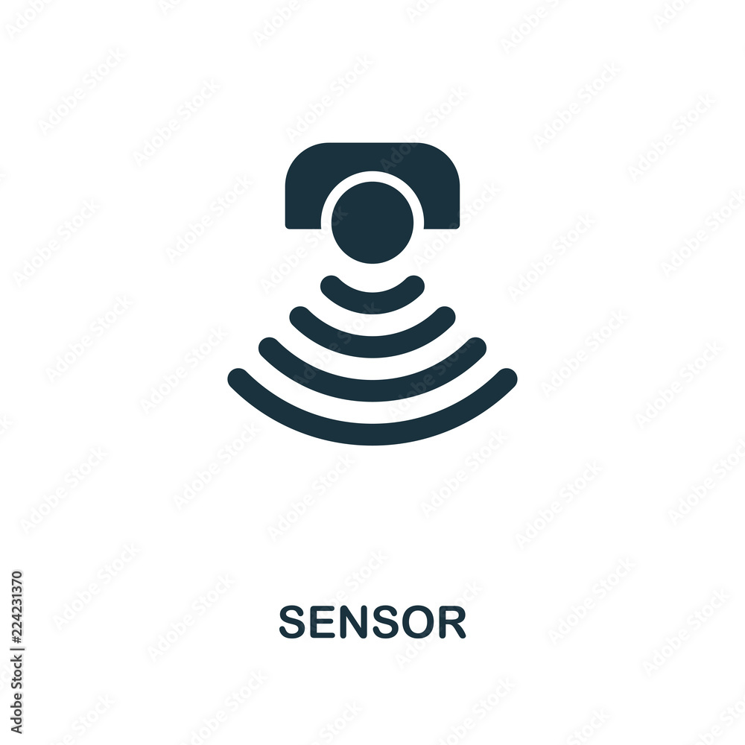
Summary
Components of our system:
Sensors: Functionally demonstrable
Navigation: Partially demonstrable
Reactive element: Planned for demo 2
Web App: Planned for demo 3
Notes:
The FarmFriend robotic system is equipped with moisture and pH sensors to monitor soil health, from which the system can act by stabilising soil to a pH that is most optimal for the crop being grown.

Slide 6
Project process
Reactive
Web App
Component to react to different soil pH levels
Analytics from the data collected
Sensors
Navigation
Components to take soil measurements
Autonomous navigation of the system

Slide 7
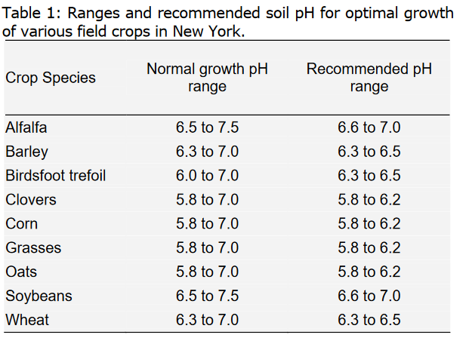
Notes:
We envision the pH stabilising component to be modular, exchangeable to cater for other nutrients, such as potassium. This further business opportunities with nutrient providers to meet towards sustainable agriculture goals. Ph was chosen to be measured because a recent survey of arable soils in the UK showed that more than 40% have a soil pH less than the optimum level of 6.5. (Holland, 2019). As we can see above, many soil pH ranges are not in the recommended range. This would be solved by regular cheap data collection.(http://cceonondaga.org/resources/soil-ph-for-field-crops)

Slide 8
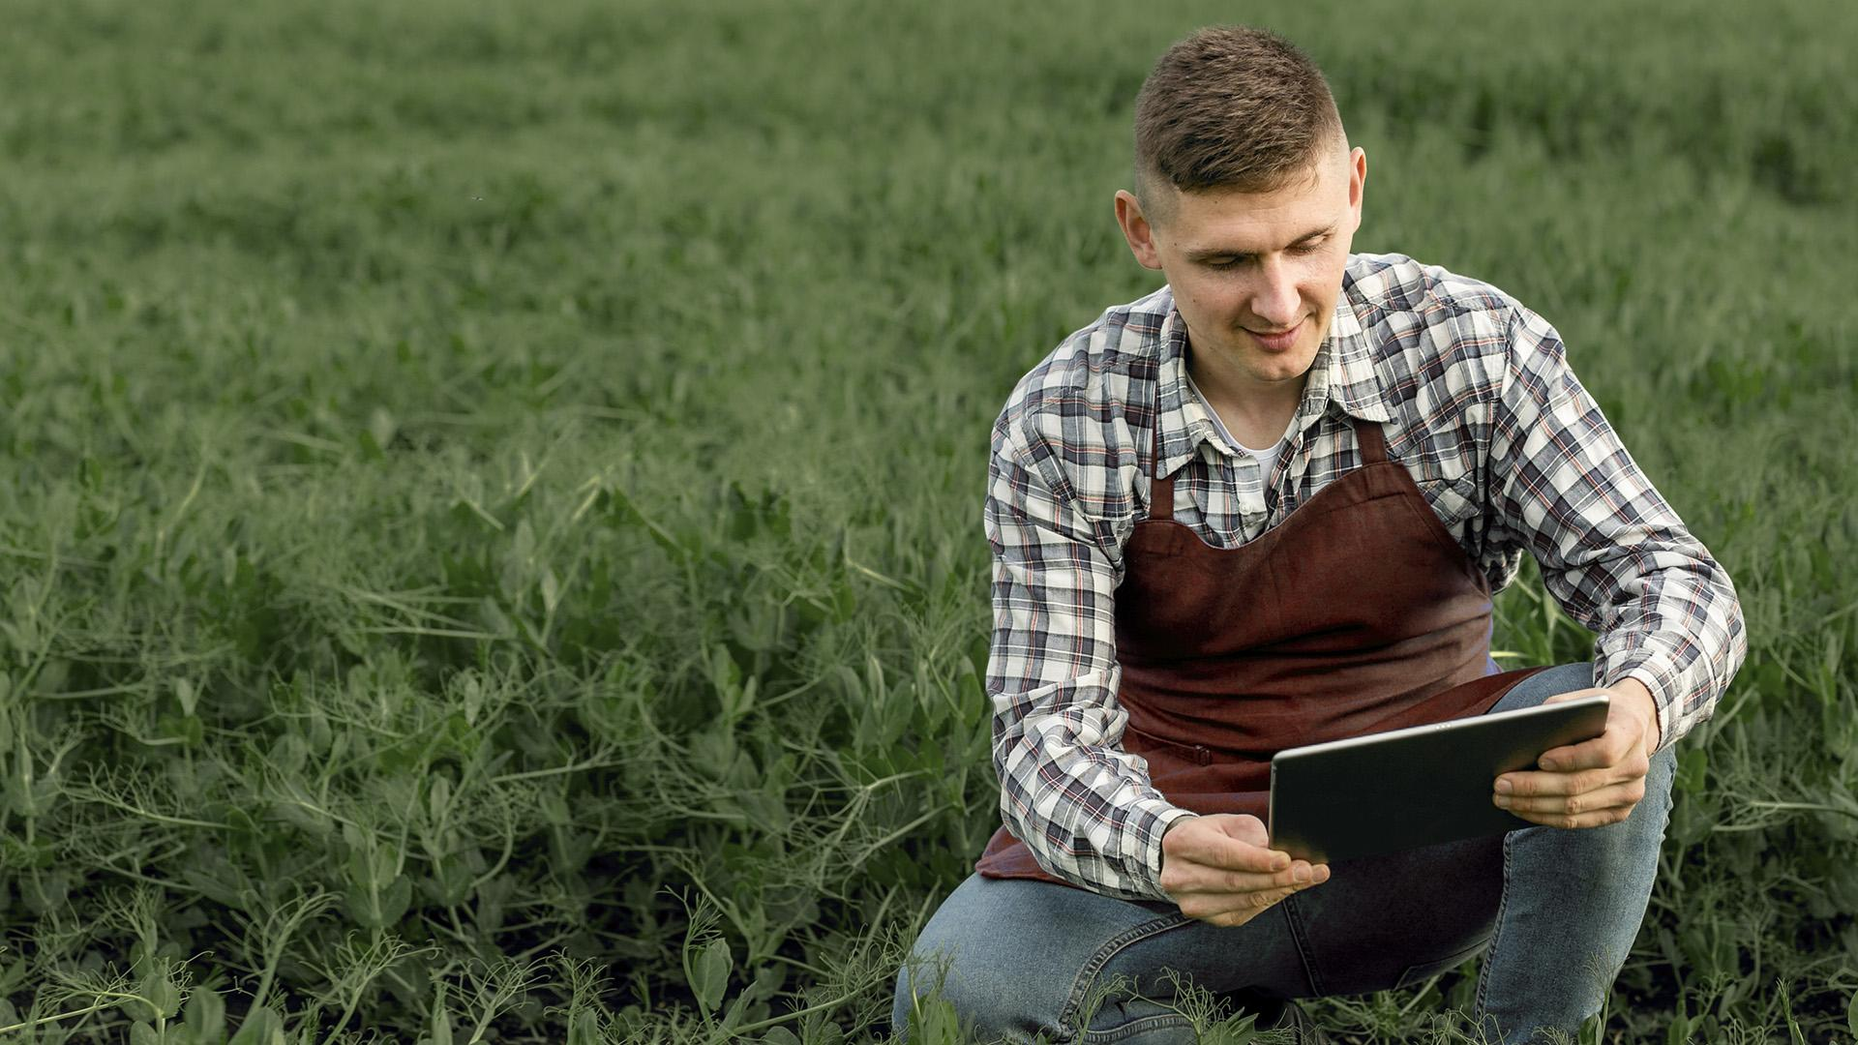
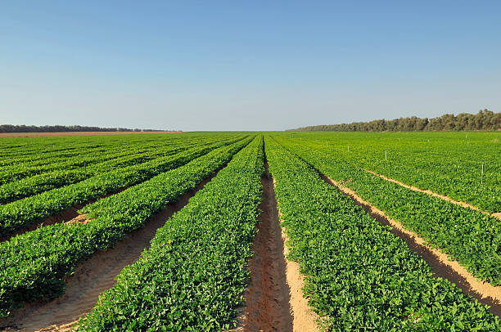
Segmentation of the field
Notes:
The robotic system will be able to autonomously navigate through a given field, gathering and up loading data to a web application which displays key statistics to the user; this allows farmers to attend to other work while crops are being measured, then view and make use of the data when needed.

Slide 9
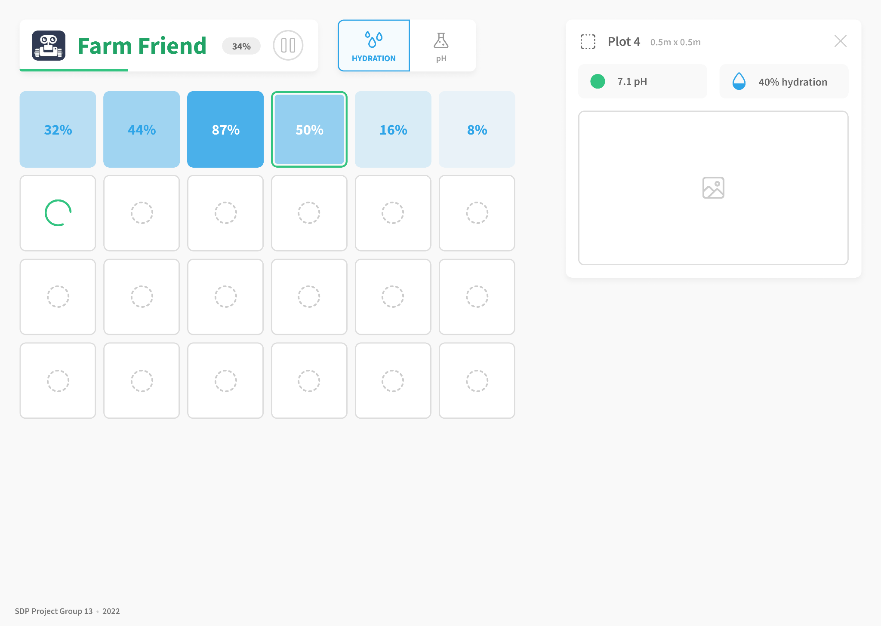
Web App UI Mockup

Slide 10
01
Value Proposition
Why is there a market?

Slide 11
Who would use it?
Farmers
Nutrient providers
Our primary user, monitoring soil health
Reactive element fitted with nutrients

Slide 12
What do farmers benefit?
Recommending preventive measures to decrease the chances of crop damage.
Optimising the productivity of individual plants through smart precision farming.
Farmers can use data such as moisture levels, soil quality and weather conditions to suggest a practical plan for harvesting.

Slide 13
Wider societal benefits
We can help prevent water wastage by showing the farmer exactly where moisture levels are low.
70%
70%
Water used for agriculture
More food needed
Agriculture accounts (on average) for 70 percent of all freshwater withdrawals globally
More food needed by 2050 to feed a growing population
Notes:
https://www.syngenta.com/en/innovation-agriculture/challenges-modern-agriculture

Slide 14
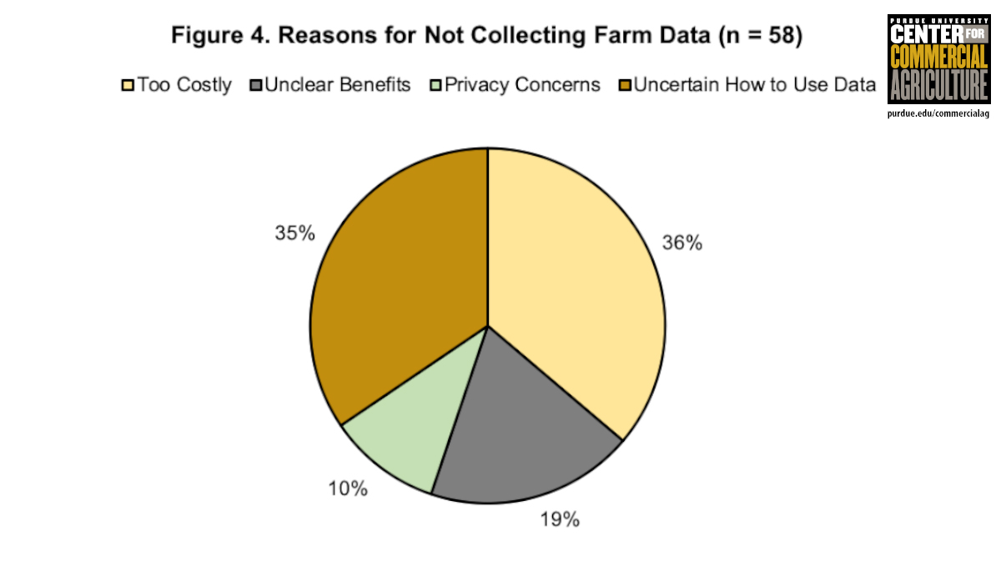
Notes:
According to (Nathan DeLay, 2020), 38% of farmers surveyed believed data collection too costly, and 35% were unaware of how to use the data effectively. This shows a large market gap for our system, as an affordable alternative to more expensive solutions. With the web app we can present the understandable data to the user allowing them to see exactly which part of their field is not optimal.

Slide 15
Why not IoT?
“Agriculture margins make tech investment tough.”
How can farmers maintain IoT themselves?
Average cost of IoT infrastructure
IoT is complex
$500 /acre
Notes:
https://readwrite.com/iot-agriculture-costs-it4/

Slide 16
02
System Overview
How does it work?

Slide 17
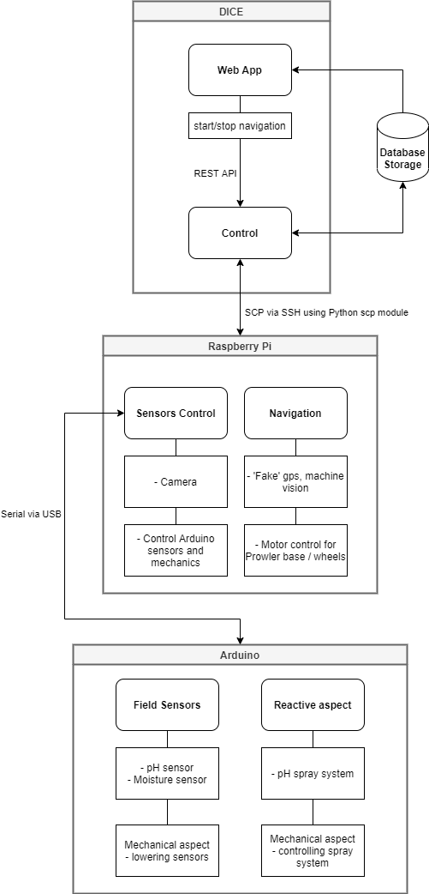



System Overview
DICE
RASPBERRY PI
Prowler
Notes:
We chose the prowler for its larger wider wheels, which provides a larger surface area to distribute the weight of the chassis onto; which means that we are able to minimise the damage to the crops.
The prowler base is also significantly more powerful as compared to the standard turtlebot; however it brings more challenges such as having our own wheel encoders and navigation system.
As opposed to a Raspberry Pi to control the sensor motor, we use an Arduino. This allowed us to modularise the development and since the moisture sensor is an arduino component it kept the entire sensor sequence in one place. Another reason is that it is easier using Arduino because there are off the shelf libraries, and in the case of Pi we need to write more complicated codes to achieve the same purpose.
The system is mounted on the prowler chassis
It is controlled using a Raspberry Pi, which communicates with the four motors for the wheels and the Arduino which currently controls the sensor system.
We use a DICE machine to control the Pi to run a script which starts the sequence
An Arduino controls a motor which turns a wheel to lower/lift the moisture sensor and the sensor itself is connected to the Arduino. A display shows the moisture reading (higher -> dryer).

Slide 18
03
Technical Progress
What have we accomplished?

Slide 19
Technical Progress
Arduino can move the sensor motor
Structure housing a wheel and toothed rod. Turning this with the motor lowers sensor into the ground, and reverses it to lift the rod
Mounted a moisture sensor on the rod which gives readings, returning it on a display
This sequence is controlled by a script that can control all aspects of the hardware
The prowler motors are connected to a Pi, which can be moved in sequence using a script

Slide 20
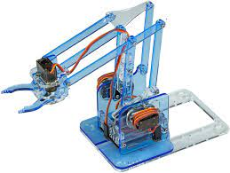
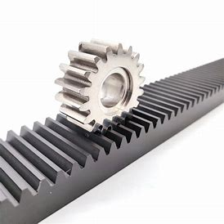
Structure-Mechanism
How to lower the sensor into the ground?
Solution 1: MeArm | Too complicated movement | Cannot put the sensor deep into the soil
Solution 2: Gear-rack design | 1 dimensional movement but meets the standard | Can put the sensor as deep as we want into the soil

Slide 21
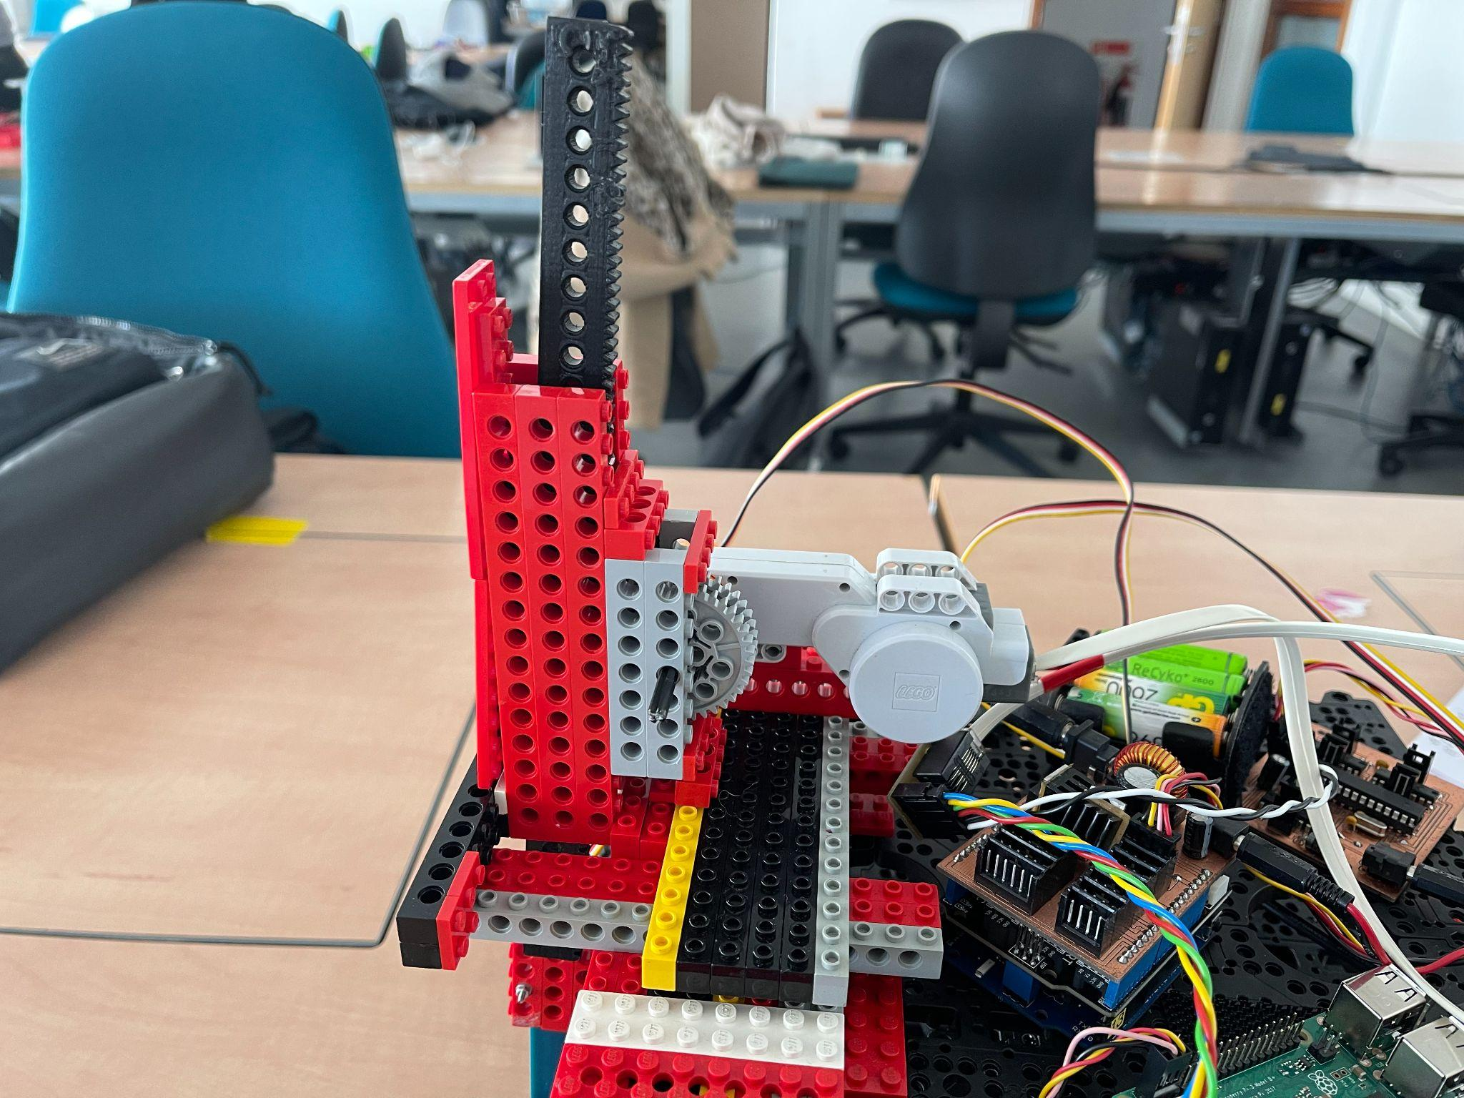

Slide 22
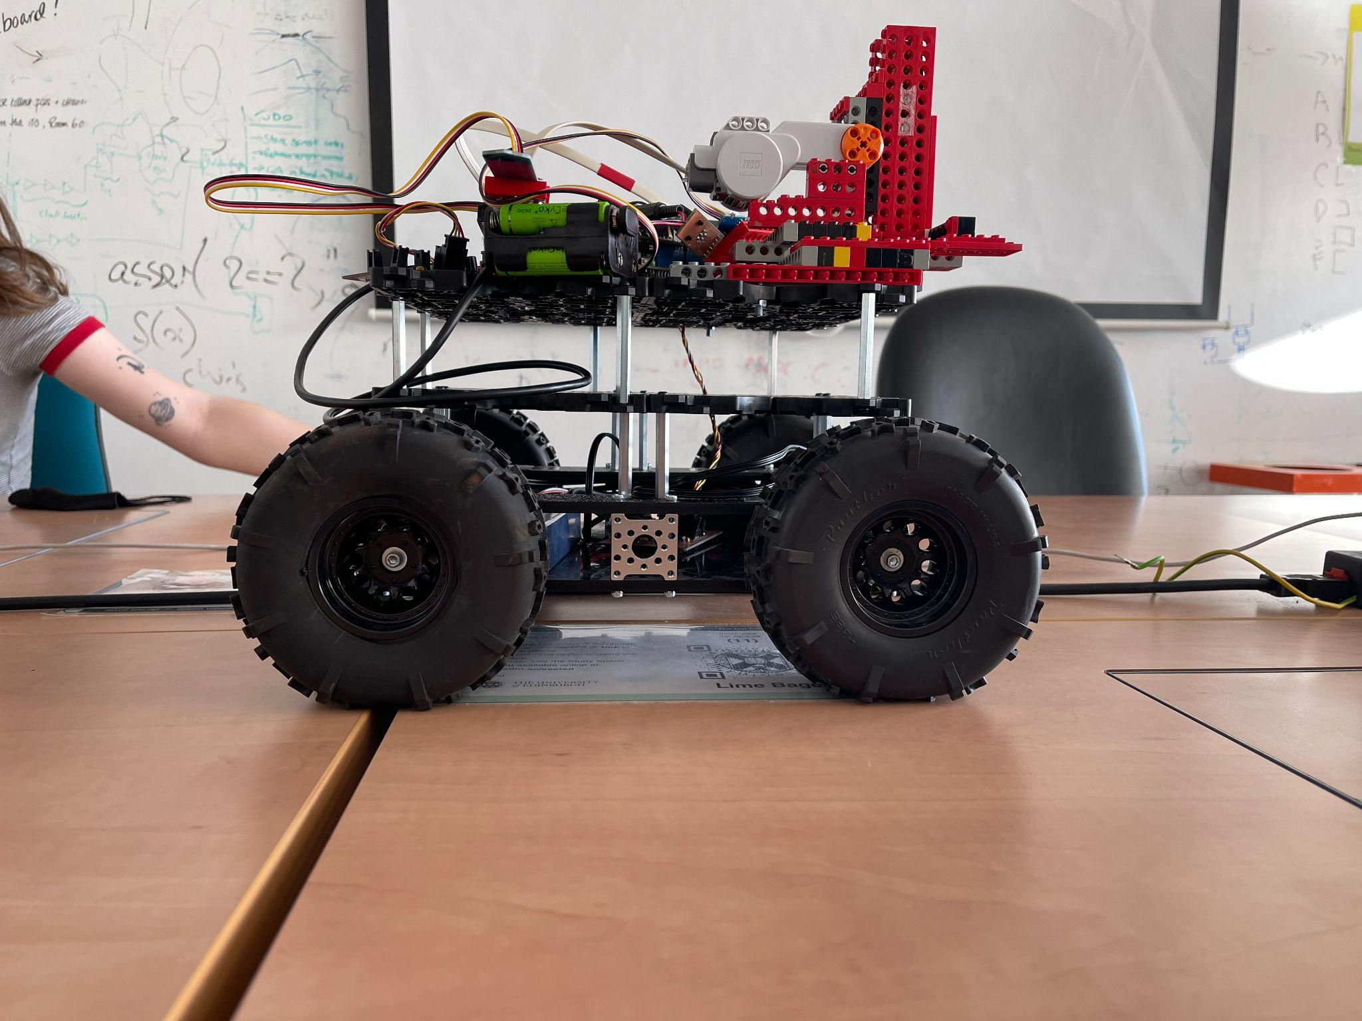
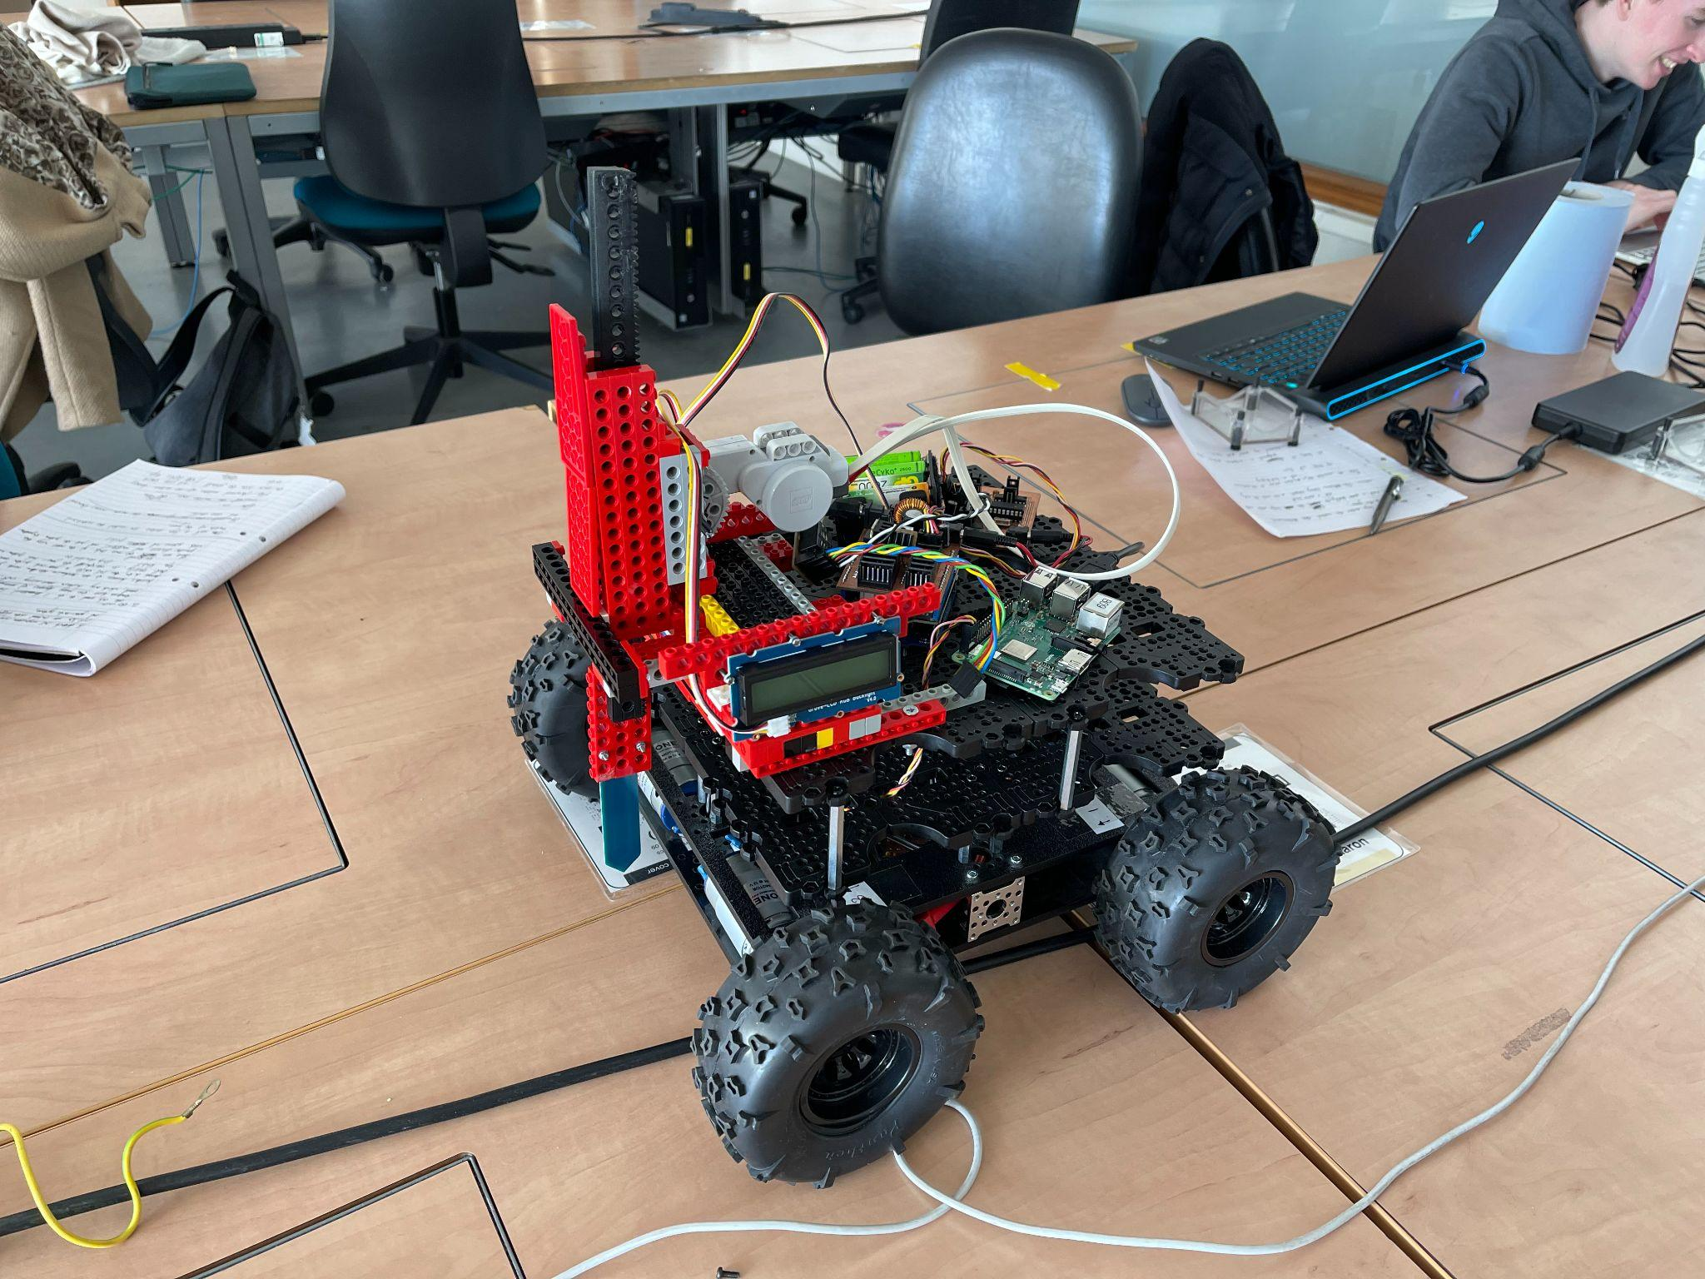
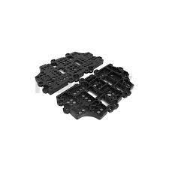
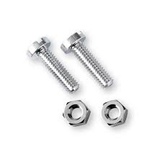
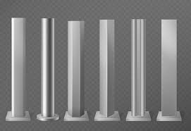
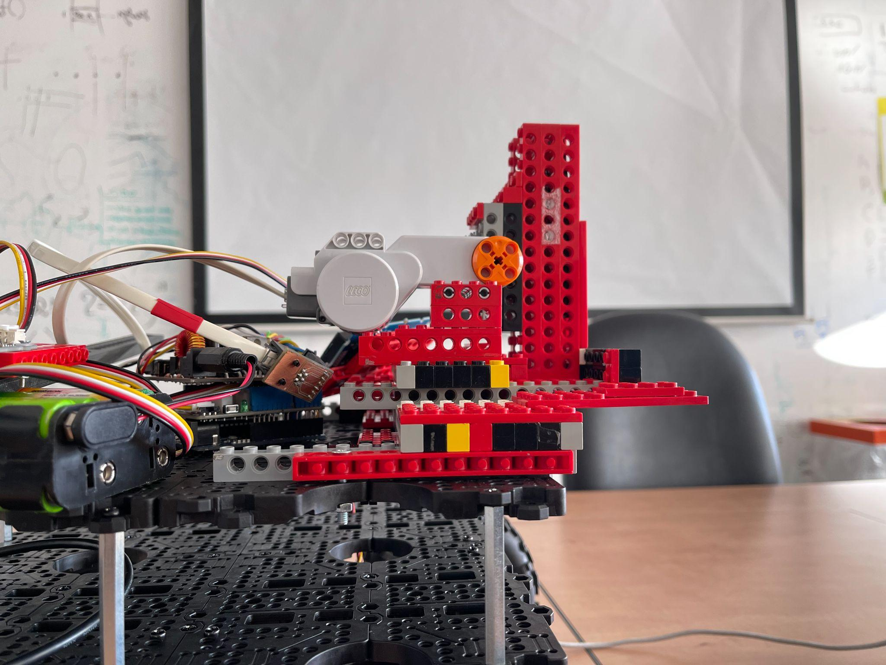
Structure-Robot body

Slide 23
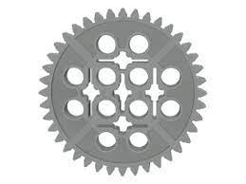
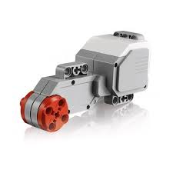

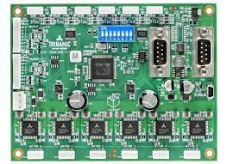
Arduino-Motor
Gear | LEGO motor | Motor board | Arduino

Slide 24
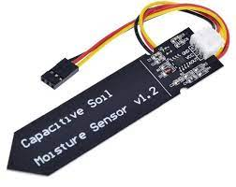
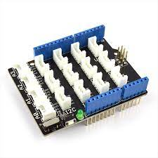
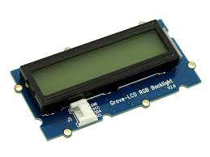
Arduino-Sensor & LCD display
Soil moisture sensor |  | Grove sensor shield | Arduino
LCD display

Slide 25
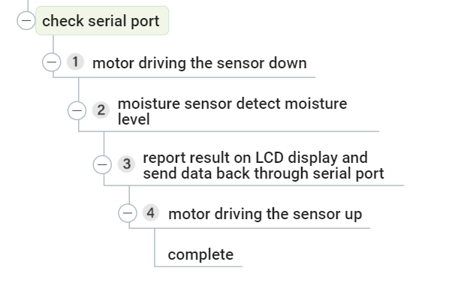
Arduino-program

Slide 26

Sensor system demo video

Slide 27
04
System Demo
Let’s see it working!

Slide 28
Questions?

